Slide 1
CHES Research Seminar: How can we measure university Global Engagement?
Janet Ilieva, PhD
Director and Founder
Education Insight

Slide 2
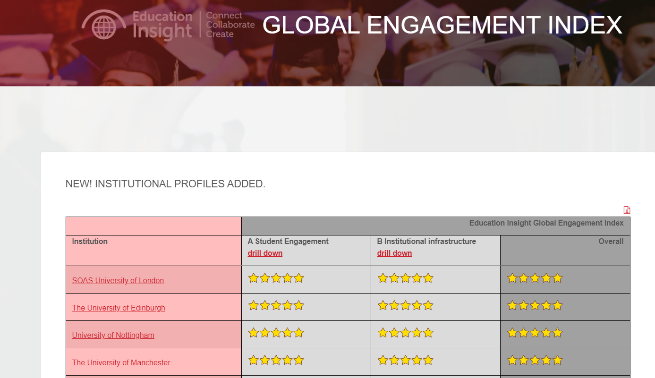
Purpose
The Education Insight Global Engagement Index (GEI) aims to support the development of institutional internationalisation strategies, and invite a conversation about global engagement
The index captures the state of education institutions’ engagement across 32 measures (HESA, OfS, Scival)
It covers areas which are excluded by most league tables: universities’ global footprint (students, campuses and operations in another country); outbound mobility; geographical diversity; internationalisation of the curriculum; graduate outcomes.
https://www.educationinsight.uk/gei/

Slide 3
Areas of interest
Often, the internationalisation of higher education is reduced to the number of international students and tuition fee income. GEI brings attention to areas, which are overlooked:
International students’ continuation rates; satisfaction with their studies and graduate outcomes
Geographical diversification of international students and HEIs’ reliance on a small number of countries
Internationalisation at home and study abroad, which is measured through (i) proportion of home students with study abroad experiences; (ii) IVES; (iii) international themes in the curricula (based on text mining of the courses’ database) and (iv) take-up of modern and foreign languages (text mining)
Sustainability and environmental impact have a prominent place in the GEI framework, which considers:
Student recruitment from ODA countries
Capacity building in ODA countries and engagement with ODA countries’ HE systems through collaborative research and teaching
Sustainable development and climate change
https://www.educationinsight.uk/gei/

Slide 4
Structure of the Global Engagement Index
Institutional Infrastructure – supply side
1 Proportion of International Academic Staff
1.1 The Proportion of Non-UK Junior Researchers
1.2 The Proportion of Non-UK Senior Researchers and Professors
1.3 The Proportion of Non-UK Senior Leadership Team
2 Environmental impact
2.1 Sustainability of Institution (People & Planet)
2.2 Staff Air Travel Carbon Footprint per Student
3 Sustainable development and engagement with ODA countries
3.1 Proportion of Fee Waivers for Students from ODA Countries
3.2 Proportion of Collaborative Research with ODA countries
4 International engagement and research
4.1 Proportion of Non-UK HEBCI Income
4.2 Impact of Research Produced in International Collaboration
5. Sustainability and climate change themes in the curricula
5.1 Sustainable development themes
5.2 Climate change themes
Student engagement – demand side
1 Diversity of International Students in the UK
1.1 Proportion of International Students (First degree; PGT and PGR)
1.2 Market Diversification (First degree, PGT and PGR)
1.3 Recruitment from ODA Countries (First degree; PGT and PGR)
2 HESA Aggregate Offshore Record
2.1 Transnational Education for Capacity Building
2.1.1 Proportion of Postgraduate Transnational Education
2.1.2 Proportion of PG Transnational Education in ODA countries
A.2.2 Delivery of Transnational Education
2.2.1 Proportion of Transnational Education
2.2.2 Proportion of Transnational Education in ODA Countries
A.3 Student Success
3.1 Continuation Rate of First Degree Int’l Students
3.2 Student Satisfaction (NSS)
3.3 Graduate Outcomes (Leavers in Study or Employment)
A.4 Study Abroad and Internationalisation at Home
4.1 Proportion of Modern Foreign Language Students
4.2 Proportion of Students with Study Abroad Experience
4.3 Proportion of Incoming Visiting and Exchange Students
4.4 International Themes Within the Curricula

Slide 5
GEI calculates the average sector performance and benchmarks the institutional performance

Slide 6
GEI enables monitoring of the HE system at a sector level
All GEI indicators can be aggregated at the sector level – this will highlight whether:
International student recruitment growth was achieved at the expense of geographical diversification
Recruitment growth was at the expense of reductions in student success
International students’ success and how we measure it
International students’ non-continuation rates
Degree outcomes
National student survey – overall satisfaction with academic experience
Graduate outcomes – students in further study and employment
Some of the above constitute part of the HE KPIs, however, the monitoring only includes home students
https://www.educationinsight.uk/gei/

Slide 7
Measures of student success
Non-continuation rates - are part of the UK HE key performance indicators as defined by HESA (https://www.hesa.ac.uk/data-and-analysis/performance-indicators/non-continuation). Data is based on the full-time, first-degree entrants. The data shows the percentage who continue at the same HE provider, transfer to another HE provider and are no longer in HE the year after entry
National student survey – uses the responses to Question 27 “Overall student satisfaction”
Degree classification data is based on all first-degree full-time qualifiers from UK institutions who gained a classified degree
Graduate Outcomes – data are based on all first-degree qualifiers from UK institutions who have known outcomes on the Graduate Outcomes Survey (e.g. in further study, employment, etc)
https://www.educationinsight.uk/gei/index.html

Slide 8
The impact of the pandemic on the students’ success
International students in the UK have a high continuation rate
The UK has a great competitive advantage over other countries regarding students’ high completion rates.
International students have a low non-continuation. However, there are notable increases in the past year.
Source: HESA Student Record: calculations for the 2017/18 and 2018/19 full-time first-degree entry cohort.
* Hillman, N. (2021), A short guide to non-continuation in UK universities; HEPI Policy Note 28; https://www.hepi.ac.uk/wp-content/uploads/2021/01/A-short-guide-to-non-continuation-in-UK-universities.pdf
Students’ domicile | 2017-18 | 2018-19 | 2019-20 | 2020-21
UK | 6.8% | 7.7% | 6.6% | 7.7%
EU | 5.1% | 6.5% | 6.5% | 8.2%
Non-EU | 3.0% | 3.9% | 4.9% | 6.4%
https://www.educationinsight.uk/gei/

Slide 9
The impact of China on students’ non-continuation
Students from China have lower non-continuation compared to other domiciles.
Their impact on the overall non-continuation rate is notable
Source: HESA Student Record: calculations for full-time first-degree entry cohorts, various years
Students’ domicile | 2017-18 | 2018-19 | 2019-20 | 2020-21
China | 2.0% | 2.7% | 2.1% | 2.9%
Non-EU (excluding China) | 3.5% | 4.5% | 6.4% | 8.3%
https://www.educationinsight.uk/gei/

Slide 10
Non-continuation varies from country to country
Source: HESA Student Record: non-continuation rates for full-time first-degree entry cohorts, various years
https://www.educationinsight.uk/gei/

Slide 11
Degree outcomes
Source: HESA Student Record: first-degree qualifiers from UK HEIs.
https://www.educationinsight.uk/gei/

Slide 12
Domiciles with the highest/lowest proportion of students gaining a first or upper second class degree
Source: HESA Student Record: first-degree qualifiers from UK HEIs.
https://www.educationinsight.uk/gei/

Slide 13
International students’ satisfaction with their academic course (NSS)
Impact of the pandemic on last year’s level of satisfaction with the academic course – the importance of this area will grow
Data sources: 2019, 2020 and 2021 NSS results; Analyst: Office for Students, Information for Students Team
Response to FOI request
Region of domicile | Q27 Agreement Rate (2019) | Q27 Agreement Rate (2020) | Q27 Agreement Rate (2021) | Q27 Agreement Rate (2022)
EU (excluding UK) | 81.28% | 80.33% | 75.15% | 77.04%
Rest of World | 84.05% | 83.74% | 77.74% | 80.06%
UK | 83.76% | 82.68% | 75.20% | 75.80%
https://www.educationinsight.uk/gei/

Slide 14
Graduate Outcomes
Source: HESA Graduate Outcomes data. Calculations are based on all first-degree qualifiers to UK institutions who have known outcomes on the Graduate Outcomes Survey
https://www.educationinsight.uk/gei/

Slide 15
Other significant shifts at the sector level

Slide 16
The pivot: percentages and numbers
Master’s entrants increased from 52% in 2017 to 68 per cent in 2021
First-degree entrants, whose proportion dipped from 39 per cent in 2017 to 26 per cent in 2021.
In absolute terms, first-degree entrants dipped by over 16,300 students and PhD entrants by 1,100.
Over the past year, the intake of master’s students increased by almost 62,000 students.
Source: HESA Standard registration population, various years.
https://www.educationinsight.uk/gei/index.html

Slide 17
There is a growing reliance in India
Urgency is required to:
actions to diversify markets
ensure a more balanced distribution of international students across programmes of study
Institutional-level analysis is required to establish the levels of reliance on 1 market
Source: HESA Standard registration population, various years.
https://www.educationinsight.uk/gei/index.html

Slide 18
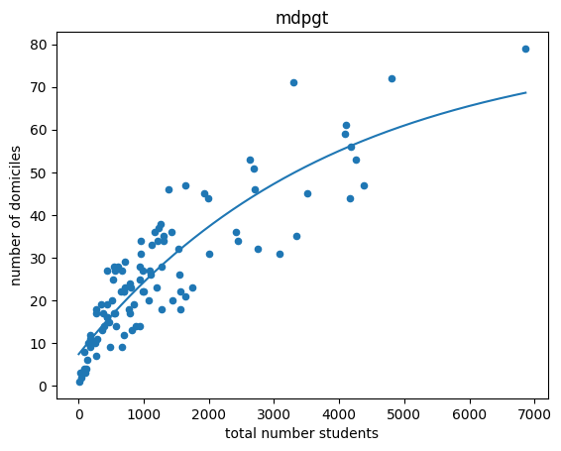
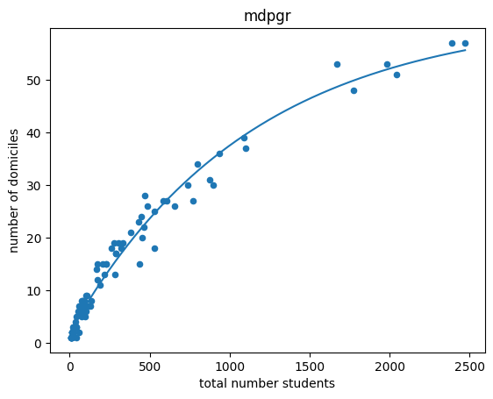
Geographical diversity of international students and the importance of recruitment pipelines/pathways
International postgraduate taught students
International postgraduate research students
https://www.educationinsight.uk/gei/

Slide 19
Market diversification at the postgraduate taught level: growing reliance on a small number of countries
The number of HEIs recruiting more than half of their students from one country has increased over the past three years from 42% to 50%
Those recruiting from 2 countries have doubled from 16% to 32%
Those recruiting from over two countries have dropped significantly
The reliance on China is being replaced with dependence on India
China dropped from being the top market for 55% of the HEIs in 2017/18 to 35% in 2020/21 This may be attributed to reductions in PGT entrants from China
India increased from 15% in 2017/18 to 46% in 2020/21
https://www.educationinsight.uk/gei/

Slide 20
However, studying the market diversification at the PGR level over time shows a worrying growth in reliance on a small number of countries
The number of HEIs recruiting more than half of their students from one country has increased over the past three years from 24% to 33%
Those recruiting from 2 countries increased from 20% to 34%
Those recruiting from more than countries have dropped significantly
The proportion of HEIs with China as a top market increased from 34% in 2017/18 to 51% in 2020/21
While the number of Nigerian doctoral entrants increased, the proportion of HEIs with Nigeria as a top source country dropped from 28% to 22%
https://www.educationinsight.uk/gei/

Slide 21
GEI enables HEIs to assess their IHE endeavours and benchmarks their performance against peers

Slide 22
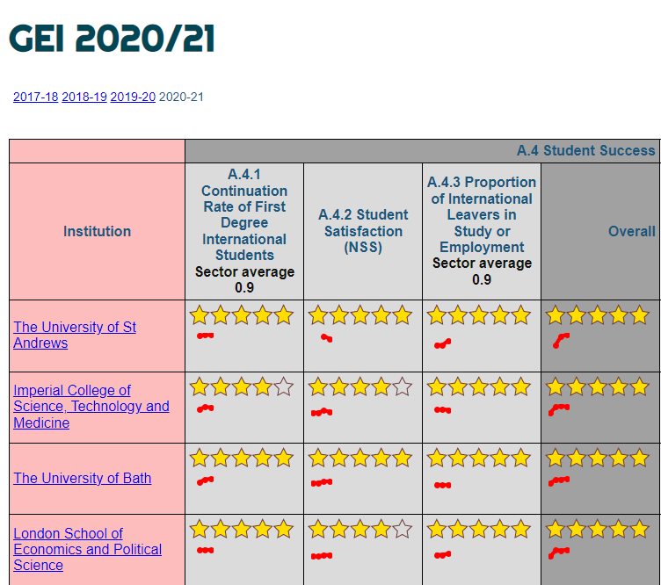
There are significant variations at the institutional level
HEIs with high proportions of EU and Chinese students tend to perform well across most student success measures
Those for HEIs with growth rates in international students over the past few years appear to have been affected negatively
Source: Time series student success indicators https://www.educationinsight.uk/gei-p/ss_2020-21.html
Calculations based on analysis of HESA Student Record different years. See methodology at
https://www.educationinsight.uk/gei/index.html

Slide 23
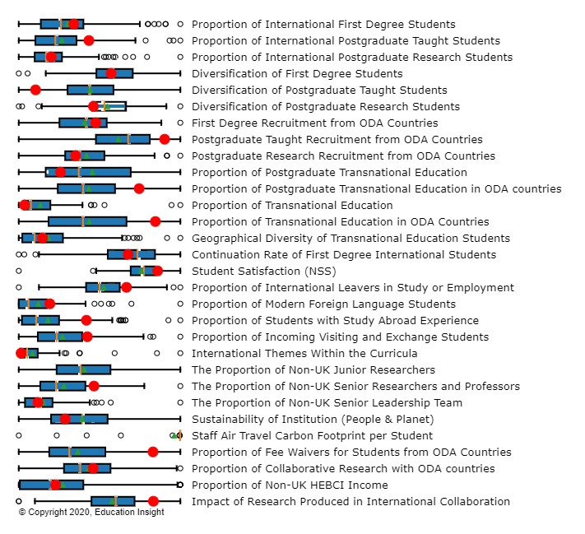
Areas of strengths
Strong performance across most student engagement areas
Strong engagement with ODA countries:
Student recruitment
TNE in ODA countries
Tuition fee waivers for ODA students
Very strong on MFL and study abroad
Highly impactful research produced in int’l collaboration
Room for improvement in:
Diversity of the student body at masters’ (2/3+ from one country) and PGR level
Continuation rate for the 2017/18 cohort

Slide 24
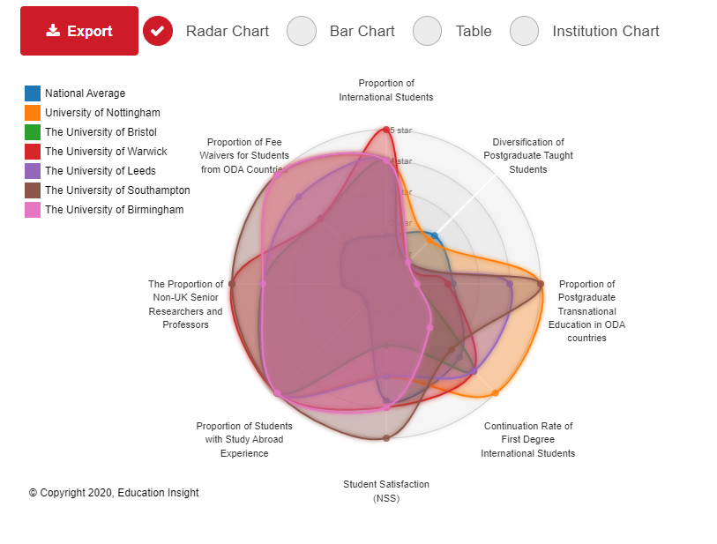
Benchmarking institutional performance
Areas of excellence against the competitor group:
Most peer-group HEIs perform competitively on study abroad
The comparator group performs below the sector average in PGT diversification (reliance on China)
Areas of excelence:
Relative size of the international student body (%)
Student satisfaction
PG TNE in ODA countries
Fee waivers for ODA students
Global talent attraction (% of non-UK senior researchers)
Room for improvement in:
Continuation rate for international students*
Market diversification at PGT and PGR levels
For details visit the GEI website
https://www.educationinsight.uk/gei/

Slide 25
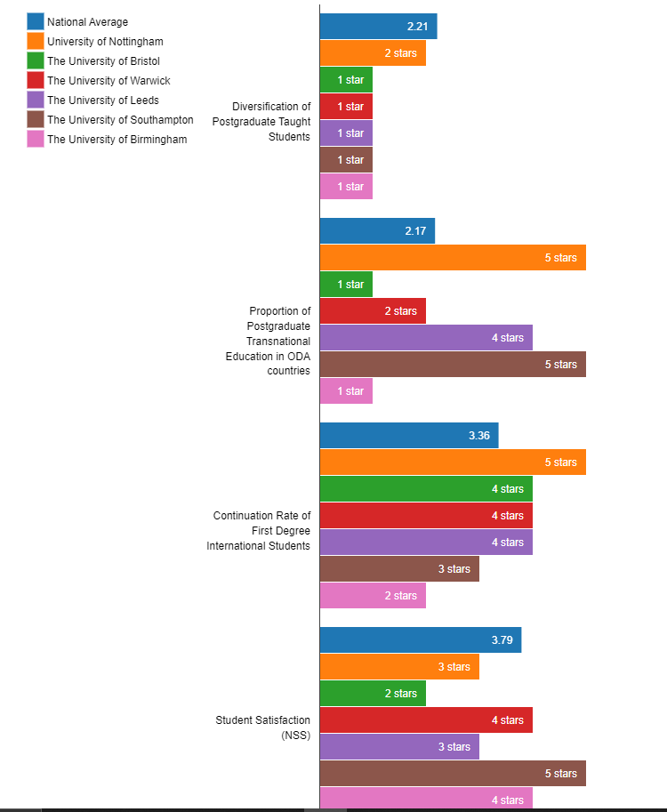
Peer group comparisons
Less geographical diversity in students recruitment makes the HEIs reliant on a small number of countries where they are highly selective (using established pathways)
Most RG universities outside London are heavily reliant on China
The above may be problematic in the context of deteriorating geopolitical tensions with China. Anecdotal evidence suggests increases in ATAS rejections
https://www.educationinsight.uk/gei/

Slide 26
Discussion
Research shows that universities and students are increasingly preoccupied with sustainable development issues. The United Nations Sustainable Development Goals (SDGs) provide an excellent framework for global engagement to advance health and education and tackle shared challenges like climate change, poverty, and food security
Most apparent areas for improvement relate to market diversification. However, any modifications will take years to come to fruition – this requires the development of recruitment infrastructure across markets. Which are your best performing recruitment pipelines?
Student success measures will be critical for attracting global talent: continuation rates, student satisfaction, graduate outcomes
https://www.educationinsight.uk/gei/

Slide 27
References
Global Engagement Index https://www.educationinsight.uk/gei/
Data Methodology https://www.educationinsight.uk/gei/indicators.html
Comparison tool https://www.educationinsight.uk/gei/indicators.html
ODA Countries* https://www.oecd.org/dac/financing-sustainable-development/development-finance-standards/daclist.htm
*The tables use the list for 2018 and 2019, which includes China (PRC) and India.
Institutional profiles: click on the institutional link
https://www.educationinsight.uk/gei/

Slide 28
Thanks!
janet.ilieva@educationinsight.uk
@janetilieva
https://www.educationinsight.uk/gei/

