Slide 1
The UCL Academic Communication Centre and the IOE Academic Writing Centre warmly welcome you to the:
IOE Academic Writing Seminar Series

Slide 2
Reviewing the Literature: A critical view
Ruanni Tupas

Slide 3
Reviewing the Literature: A critical view
RUANNI TUPAS
Department of Culture, Communication and Media
Institute of Education
University College London

Slide 4
A CRITICAL
VIEW
BUILDING DISCIPLINAL KNOWLEDGE
“The process of ‘becoming’ a researcher involves placing oneself inside a conversation and learning the intricacies and contours of a topic.”
Itchuaqiyaq and Frith, 2022, p.10

Slide 5
A CRITICAL
VIEW
BUILDING DISCIPLINAL KNOWLEDGE
“…citational practices do infrastructural work and are a discursive base upon which entire disciplines…are built.”
Itchuaqiyaq and Frith, 2022, p.11

Slide 6
A CRITICAL
VIEW
BUILDING DISCIPLINAL KNOWLEDGE
A researcher: “cannot perform significant
research without first understanding the literature in the field” (p. 3).
Boote and Beile, 2005, p. 3

Slide 7
A CRITICAL
VIEW
BUILDING DISCIPLINAL KNOWLEDGE
Literature review is the demonstration of knowledge of the field.
SO: what and who constitutes ‘knowledge of the field’?

Slide 8
A CRITICAL
VIEW
BUILDING DISCIPLINAL KNOWLEDGE
Can I consult literature in languages other than English?
Where does most research I cite ‘come’ from?
What does my citation line reveal about what I know and do not know?

Slide 9
A CRITICAL
VIEW
BUILDING DISCIPLINAL KNOWLEDGE
“[s]ocial scientists in the dependent centres of academic production
are obliged to acquaint themselves, if not master, both the classics and the
latest theoretical trends emanating from the dominant centres”
(Guillermo, 2023, p. 4)

Slide 10
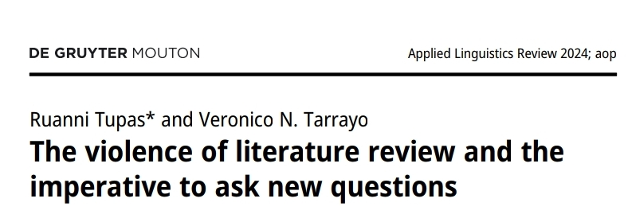
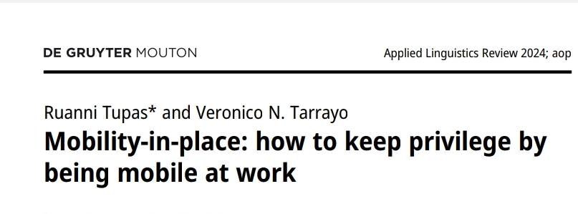
Language in Research Questions
A CRITICAL
VIEW
REVIEW-ING the LITERATURE

Slide 11
A CRITICAL
VIEW
REVIEW-ING the LITERATURE
Research project:
Attitudes of Filipino professional writers of English
towards a named variety of English called ‘Philippine English’of English called ‘Philippine English’.

Slide 12
A CRITICAL
VIEW
REVIEW-ING the LITERATURE
Research project:
In the academic literature, respondents are usually asked directly what they think of ‘Philippine English’, or ‘Thai English’, or ‘Malaysian English’.

Slide 13
A CRITICAL
VIEW
REVIEW-ING the LITERATURE
Research Questions:
What are the attitudes of Filipino elite professional writers towards ‘Philippine English’? (e.g. clines of favorability and acceptability)
Do they think they speak Philippine English?
What is the role of Philippine English in their professional lives?

Slide 14
A CRITICAL
VIEW
REVIEW-ING the LITERATURE
Language De-centered Research Questions:
What do elite Filipino writers in English think of their profession? (e.g., description of the kind of work that they do)
What challenges, if any, do they face at work?

Slide 15
A CRITICAL
VIEW
REVIEW-ING the LITERATURE
For Topnotch Brand A [real name anonymised], my voice there would be very formal and sophisticated, for Topnotch Brand B, it’s going to be like dapper, medyo (‘quite’) formal, sophisticated. Topnotch Brand C, that’s the part where we become millennial-speaking and GenZ-speaking … And then for Topnotch Brand D, that’s the time we start using like, I don’t want to say you know when the masa-masa [I don’t want to say it is really straightforward ‘common people’] parang more on masa na [although it does look like it is associated with this big group of people], yung mga words na mas madali nilang ma-understand [we just use words which are easy to understand] because we tried talking to the Class E and D. So, we don’t, we can’t use any highfalutin words like we can’t say ‘oh, I’m flabbergasted’, you know, we just say something that must be understandable like ‘Oh wow’, ‘It’s amazing’ something like that.

Slide 16
A CRITICAL
VIEW
REVIEW-ING the LITERATURE
The writers conceptualize their own use of English in ways which radically depart from mainstream conceptualization of ‘Philippine English’.
We were able to characterize elite use of English in the country in terms of the mobilization of flexible language resources along the lines of formality/informality, access to quality education and cultural capital, by the professional writers to keep themselves useful and marketable within their professional world.

Slide 17
A CRITICAL
VIEW
REVIEW-ING the LITERATURE
Research in general (see Ahl 2004; Herndl 1993; Potts and Brown 2015) acts as a social practice of legitimizing knowledge which society has also – in fact, already – validated as legitimate.
Literature review, as a site of scholarly conversations, dictates
the kinds of questions we ask, thus unwittingly framing our research according to the epistemic demands of past and recent studies. By asking a different set of questions, ‘new’ or different understandings about certain social phenomena may emerge.

Slide 18
A CRITICAL
VIEW
DISCIPLINED KNOWLEDGE
“It follows that the academic discipline can be seen as a form of specific and rigorous scientific training that will turn out practitioners who have been ‘disciplined by their discipline’ for their own good. In addition, ‘discipline’ also means policing certain behaviours or ways of thinking. Individuals who have deviated from their ‘discipline’ can be brought back in line or excluded” (Hammarfelt, 2016, p. 8).

Slide 19
A CRITICAL
VIEW
UNSETTLING DISCIPLINED KNOWLEDGE
Interrogate Citational Practices
Where do most of our citations come from and what knowledge is being prioritized?
Consider literature from underrepresented voices and from works written in languages other than English.

Slide 20
A CRITICAL
VIEW
UNSETTLING DISCIPLINED KNOWLEDGE
Review the Literature Beyond the Canon
What constitutes “knowledge of the field” and/or how does one become “an expert” in the field?
Integrate diverse sources.

Slide 21
A CRITICAL
VIEW
UNSETTLING DISCIPLINED KNOWLEDGE
Reframe and Test Different Research Questions
Given your discipline, what is your typical entry point to research?
Explore Different Entry Points to Research

Slide 22
A CRITICAL
VIEW
CONCLUSION
Research is not merely the pursuit of knowledge, but also a deliberate act of questioning what has been deemed as knowledge. By unsettling established practices and reframing our inquiries, we create space for new understandings to emerge.

Slide 23
References
Ahl, H. J. (2004). The scientific reproduction of gender inequality: A discourse analysis of research texts on women entrepreneurship. Copenhagen: Copenhagen Business School.
Boote, D. N. & Beile, P. ( 2005). Scholars before researchers: On the centrality of the dissertation literature review in research preparation. Educational Researcher, 34(6), 3–15.
Guillermo, Ramon. 2023. ‘Pagsasariling atin’: The project of an autonomous social science tradition (ASST) and the challenge of scientometrics. Third World Quarterly, 1–16.
Hammarfelt, B. (2016). Discipline. In B. Hjørland, B. & C. Gnoli (eds.). ISKO Encyclopedia of Knowledge Organization (pp. 1-22).
Herndl, C. G. (1993). Teaching discourse and reproducing culture: A critique of research and pedagogy in professional and non-academic writing. College Composition & Communication 44(3). 349–363.
Itchuaqiyaq, C. U., & Frith, J. (2022). Citational practices as a site of resistance and radical pedagogy: Positioning the multiply marginalized and underrepresented (MMU) scholar database as an infrastructural intervention. Communication Design Quarterly Review, 10(3), 10-19.
Potts, K. L. & Brown, L. (2015). Becoming an anti-oppressive researcher. In Susan Strega & Leslie Brown (eds.). Research as resistance: Revisiting critical, Indigenous and anti-oppressive approaches (pp. 17–42). Toronto: Canadian Scholars’ Press and Women’s Press.

