Slide 1
The Academic Writing Centre and the Academic Communication Centre warmly welcome you to the
IOE Academic Writing Seminar Series

Slide 2
Writing at postgraduate level: Showing, not saying, what you know
Dr Jim McKinley (UCL IOE)

Slide 3
UG to PG writing differences
Undergraduate writing
Formal academic conventions (e.g., objective)
Appropriate style (e.g., argument)
Postgraduate writing
“showing” not “saying”* (immerse readers in the story)
”criticality” and “originality (or “creativity”)
Notes:
“Show, don't tell” means you should immerse readers in the story rather than merely stating the story to them…

Slide 4
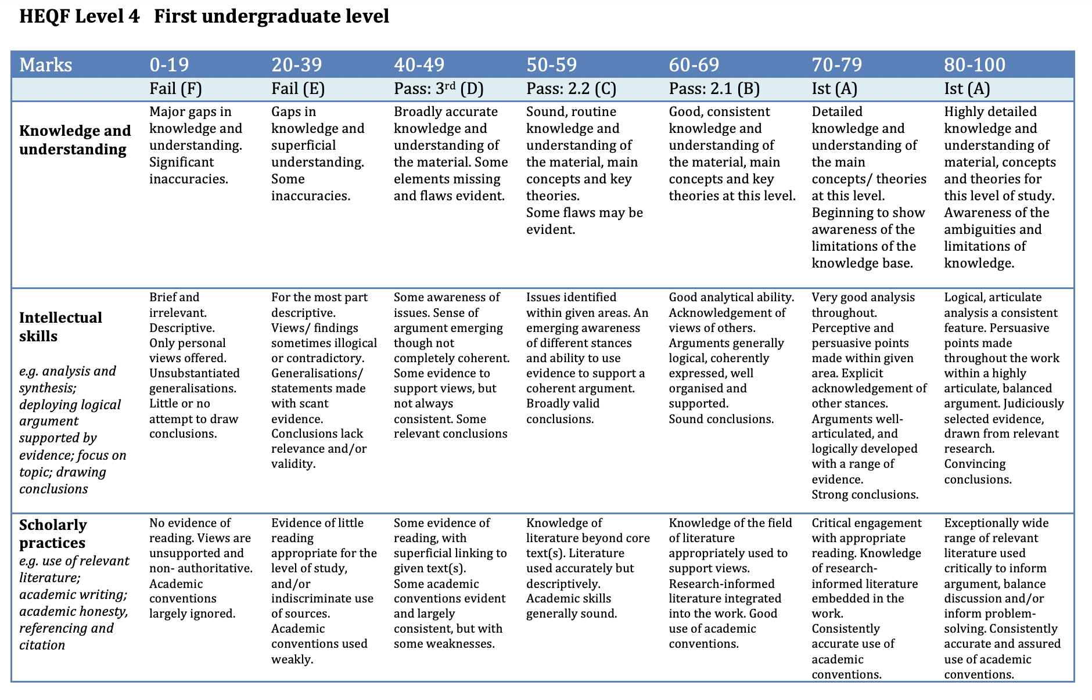

Slide 5
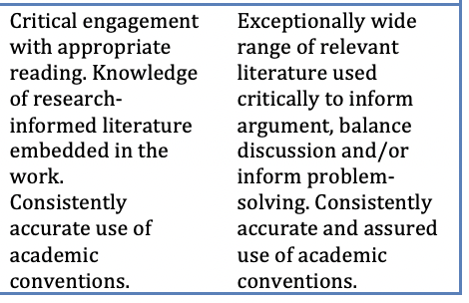
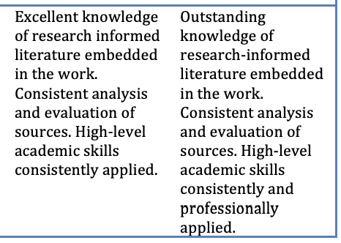
Criticality in UG marking criteria
Criterion: Scholarly Practices / Level: 1st (A)
Notes:
1st vs final year UG marking criteria – shift from critical to ‘consistent analysis’??

Slide 6
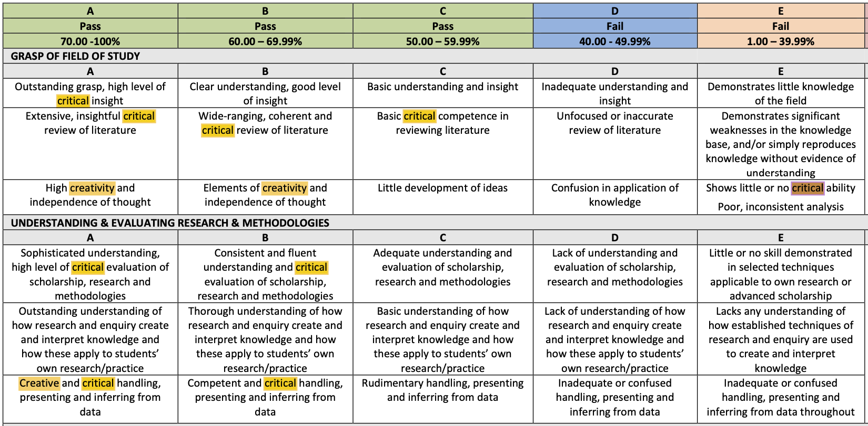

Slide 7
A sample PG assignment prompt
This assessment has three parts, which are submitted together as one assignment of 5,000 words in total. All three parts need to demonstrate engagement with and application of theories of language acquisition.
1. 2,500-word written study outlining a SLA theory. You will evaluate the effectiveness of a relevant approach informed by the theory and its impact on learners’ skills development and include critical reflection on the learning gained from the assignment. (2,500 words)
2. Analysis of and reflection on approaches to language and literacy development used in an observed English language lesson (1,250 words).
3. Review of English language teaching related material (course book or online material) which demonstrates engagement with theories of language and literacy development (1,250 words).
The grade for the assessment will be awarded holistically, to include all three parts. If an element is missing, the assignment will be given a fail grade.

Slide 8
Example successful response – Part 1
Background overview
Theory outline
Classroom application
Evaluation
Effectiveness
Limitation
Critical reflection
Part 1. 2,500-word written study outlining a SLA theory. You will evaluate the effectiveness of a relevant approach informed by the theory and its impact on learners’ skills development and include critical reflection on the learning gained from the assignment.

Slide 9
Example response – Part 1 (evaluating effectiveness)
The lexical approach also obfuscates the vocabulary/grammar dichotomy, proposing “a fundamentally different attitude to the treatment of text” (Lewis, 1993: 106). It steers towards the teaching of words in combination (Dellar & Walkley, 2016) as a major linguistic resource for text analysis and meaning understanding. Following the notion of holistic, non-linear learning, the lexical approach criticizes the structural syllabus that divides grammar entities and minimizes the lexis interference. Instead, it encourages in which students can achieve language success through interaction targeting task-based language learning both communicative power and language skills. Only within such interactions can learners produce language naturally, based on the use of supra-sentential lexical links that illustrate the cohesive turns in a conversation (McCarthy, 1992; Lewis, 1993).
Competent & critical (grade B):
lexical approach with the vocabulary-grammar dichotomy +
task-based language learning

Slide 10
Example response – Part 1 (evaluating limitations)
With ELT [English language teaching] materials often failing to respond to research findings in the field of Applied Linguistics (Harwood, 2002), the ever-updating lexis also challenges the notion of “real lexis” in teaching EFL [English as a foreign language]. Without attested materials that serve as guidelines for teachers and institutes, some may fall into a deadlock that to teach “real lexis” means to use slang and idioms, and only “native” teachers are qualified for it. Regarding the use of a corpus, limited access to corpora database for individual teachers may escalate the polarization and stereotypes of native and non-native teachers in lexical teaching (Bao, 2018).
Creative & critical (grade A):
The challenge of “real lexis”
+
Native vs. non-native teachers

Slide 11
Example response - Part 1 (reflection)
Reflecting on my own English learning experiences, the lexical approach has been beneficial for me. Bearing in mind that language can be perceived as chunks pushes me to design and use my own vocabulary worksheets that require me to note the integrated units in the materials that I have encountered consciously. It also helps me form habits of self-learning. On the one hand, I always check the words or expressions that go together, and on the other hand, influenced by the notion of a spectrum of likelihood and conventionality (Lewis, 2008), it allows me to view critically the concept of “standard English”, and to be aware of the cultural and idiosyncratic features of the language.
(Grade A) Outstanding understanding of how research and inquiry create and interpret knowledge and how these apply to students’ own research/practice.

Slide 12
Example less successful response – Part 1
Background
Theoretical Features
Methodological Features
SLA theory of Approach
Its Application in class
Reflection
Part 1. 2,500-word written study outlining a SLA theory. You will evaluate the effectiveness of a relevant approach informed by the theory and its impact on learners’ skills development and include critical reflection on the learning gained from the assignment.

Slide 13
Example less successful response - ‘methodological features’
Notwithstanding, several linguists partly shift their opinion and in turn show the favor towards the approach recently or at least of lexical teaching. Timmis, who seems to blame the approach in sharp words, gradually senses that the partly useful approach could make a new scope via which teachers can raise the awareness of collocations and chunks since they are really of importance, though the measure still remains debatable (2008). Woolard advocates to apply the approach in a limited way, he argues ‘the principle that the internal construction of a chunk should only be analysed when a learner needs to vary the structure in some way to create new messages’ (2013). The inspiration is that students can unveil the in-depth grammars that hide behind these ‘prefabricated chunks’, grasp the common law and replicate or reconstruct some new units or chunks in an appropriate way. Dellar and Walkley turn to ‘teach lexically’ because lots of patterns in the lexis are to a certain extent generative (2016), small units like hints and sources which are helpful to divergent thinking in creating some new phrases.

Slide 14
Tutor written feedback
The evaluation of the Lexical Approach shows sound knowledge of basic facts and arguments, but it fails to cover key aspects of the link between theory and practice in teaching English, making insufficient reference to the task. For example, in the introduction you state, “several linguists partly shift their opinion and in turn show the favor towards the approach recently or at least of lexical teaching.” As this was the framing of your paper, set up as a counter-argument to key criticisms from Swan and Thornbery, it’s a missed opportunity that their arguments aren’t more strongly critiqued, instead using a subjective critique of Timmins’ work and relying on thin support from Woolard.

Slide 15
Example less successful response – Part 1 (reflection)
However, the question is how to strike a balance between Lexical Approach adoption and obedience to test-oriented assessment system. Although as a beneficiary of the approach, I am so clear about the value of the approach, which can compensate for the shortcomings of grammar-translation—one of the most commonly-used methods in Chinese classroom, it may not be the mainstay in the foreseeable days to come. The main reasons are two as follow. One is lacking in necessity. In China, those who take up posts that has nothing to do with foreign literature, linguistics, translation and so on account for the majority of the working class, so there exists no incentive for them to learn foreign language as idiomatic as native speakers, instead, foreign language is more likely to be a tool or index to pass tests, not to mention to expose themselves to natural lexical chunks and command them. The other reason is infeasibility. Commoners in China (SLA learners included) have rare opportunities to immerse themselves in L2 language environment, because returned students as well as foreign teachers are in minority compared with the enormous population.
(Grade C)
Basic / problematic* understanding of how research and inquiry create and interpret knowledge and how these apply to students’ own research/practice.

Slide 16
How do we ensure students meet expectations?
Provide examples showing how critical engagement requires support, but also a creative approach (that may best be achieved through reflection or personalised approaches)
Confirm that the task prompt aligns with the marking criteria
Provide formative feedback responding to both of these points
What else?
Notes:
“Show, don't tell” means you should immerse readers in the story rather than merely stating the story to them…

Slide 17
Thank you!
j.mckinley@ucl.ac.uk
Twitter: @DrJimMcKinley
jimmckinley.me

