Slide 1
The Academic Writing Centre and the Academic Communication Centre warmly welcome you to the
IOE Academic Writing Seminar Series

Slide 2
Examining L2 learners’ perceptions of their writing strategies on an intensive EAP course in the UK
Dr Diana Mazgutova (University of Leeds) with input from Dr Judith Hanks

Slide 3
Overview
Background to the study
Methodology
Findings
Pedagogical implications
Directions for future research

Slide 4
Background to the study
Writing is a core academic skill.
L2 learners are often not well-prepared for major change.
L2 learners often lack confidence in writing.
Notes:
Writing is a core academic skill – students’ success at university is determined by their performance in written assignments (Pecorari, 2016).
L2 learners who choose to pursue higher education upon completion of secondary education are often not well-prepared for this major change in their academic life (Wingate, 2007).
L2 learners often lack confidence in writing (Evans & Green, 2007; Hinkel, 2003; Shaw & Liu, 1998), have little knowledge of appropriate academic skills; therefore, transition to university studies becomes a challenging experience for them.

Slide 5
Background to the study
Learning strategies are specific actions taken by the students to make learning more effective.
Studies have been undertaken to address the strategies specific to L2 writing.
More and less successful writers differ in their use of writing strategies.
Notes:
Learning strategies are “specific actions taken by the students to make learning easier, faster, more enjoyable, more self-directed, more effective, and more transferable to new situations” (Oxford, 1990: 8).
Studies have been undertaken to address the strategies specific to L2 writing (E.G., Csizér & Tankó, 2015, Manchón, 2017, Mu & Carrington, 2007, Roca de Larios, Coyle, & Nicolás-Conesa, 2016).
More and less successful writers were found to differ in their use of writing strategies and successful writers tend to use a wider range of strategies than less successful ones (Manchón, 2001).

Slide 6
BACKGROUND TO THE STUDY
This study focuses on cognitive and social strategies.
Cognitive strategies are linked with the mental processes.
Social strategies are chosen to interact with other people.
Notes:
This study focuses on cognitive and social strategies because these two kinds of writing strategies were predominantly reported to be used by the students in our study.
Cognitive strategies are linked with the mental processes involved in referring to background knowledge, making assumptions and drawing inferences (Khaldieh, 2000).
Social strategies or sociocultural-interactive learning strategies (Oxford, 2016) are chosen by the L2 writers to interact with other people, e.g., tutor or peers, to reduce anxiety and boost motivation.

Slide 7
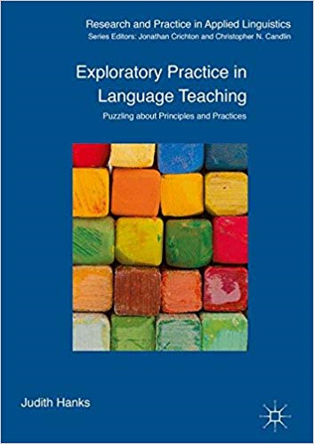
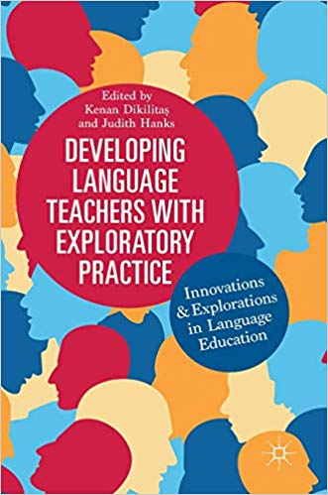
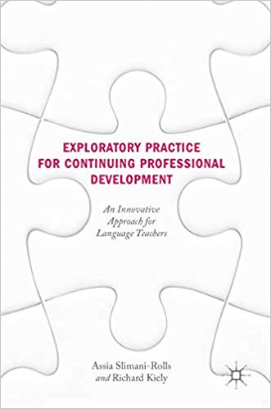
Exploratory Practice: teachers and learners researching practice (see Allwright & Hanks, 2009; Hanks, 2017) (see also: Dikilitas & Hanks, 2018; Hanks, 2015a, 2015b; Slimani-Rolls & Kiely, 2019)

Slide 8
METHODOLOGY
Research Question
What were the L2 learners’ perceptions of their own writing strategies at the beginning and at the end of the pre-sessional EAP programme?

Slide 9
Methodology
Setting
A 4-week EAP programme at a UK university
15 hours of in-class instruction a week and at least 15 hours of self-study
One-to-one weekly tutorials
Three modules studied on the EAP course:
Academic Reading and Writing
Listening Reading and Discussion
Oral Presentations
Notes:
A 4-week EAP programme at a UK university
15 hours of in-class instruction a week and at least 15 hours of self-study
One-to-one weekly tutorials to discuss feedback on assignments
Three modules studied on the EAP programme:
Academic Reading and Writing
Listening Reading and Discussion
Oral Presentations

Slide 10
METHODOLOGY
Participants
A group of 14 Chinese L2 learners of English
Pre-undergraduate students on an intensive EAP summer programme
~B1-B2 level of English language proficiency in CEFR (6- 6.5 in IELTS)

Slide 11
METHODOLOGY
Interviews
Two semi-structured interviews conducted with every participant.
One at the beginning of Week 1 and the other at the end of Week 4.
Every interview lasted for 25-30 minutes.

Slide 12
METHODOLOGY
Interview prompts
Week 1k 1 interview prompts
How do you see yourself as a writer?
What is your usual method of writing in English?
What steps do you follow when writing?
What is your own method of checking or rewriting what you have written?
Week 4
Do you see yourself any differently from what you were at the beginning of the EAP course?
Has your method of writing changed in four weeks? What steps do you follow when writing?
Has your method of checking or rewriting what you have written changed in four weeks' time?
1

Slide 13
METHODOLOGY
Learning journals
Three reflective entries submitted by all learners
Every entry written upon completion of a weekly assignment
No word limit imposed, but entries ranged between 500-700 words

Slide 14
METHODOLOGY
Learning journal prompts
How did you feel when you wrote in English?
How did you compose your assignment?
Did you use any specific strategies?
Where did you get the information for writing (e.g., own ideas, experiences, other peoples’ experiences, books or other sources of information)?
Did you get a teacher feedback on your writing this week? What did you think of that?
How did you feel about teacher feedback? Did you find it helpful/ understandable? Why/Why not?

Slide 15
METHODOLOGY
Data analysis
Thematic analysis (TA) applied to interviews and learning journals
Coding done according to standard practices of TA:
identifying themes and subthemes
selecting important themes and subthemes
establishing theme hierarchies and
linking themes and subthemes to theoretical frameworks (Ryan & Bernard 2003).

Slide 16
Findings
Extensive reading
Increased engagement in extensive reading
“My major is economics, so I will read more papers or other materials related to my subject…this should help me so much to improve my writing ability”
(Ppt 1, post-course interview)
Notes:
Extensive reading is viewed by learners as one of the effective ways to generate ideas for their assignments, provides them with language development opportunities, helps to enrich vocabulary, familiarises with academic register and enables to use complex syntactic structures in their own writing (Mu & Carrington, 2007).

Slide 17
Findings
Using exemplars
Increased reading of other students’ work
“I will try to write something maybe imitate I mean read an essay… a good essay about our major, I will try to imitate the writing style and use...select the useful words or expressions…”
(Ppt 14, post-course interview)
Notes:
Familiarising themselves with well-written examples of students’ work aids learners substantially in developing their own critical reading and reflection skills, helps them to form their own position and be generally well-prepared for academic writing.

Slide 18
Findings
Revision
Decreased revision for grammatical accuracy
“Before I check grammar and other mistakes, I will check that the Introduction contains my position and the main point and goals, I mean the task… “
(Ppt 5, post-course interview)
Notes:
This may stem from the L2 writers’ intention to concentrate on the flow of ideas and coherence rather than on individual grammatical and lexical flaws (Myhill & Jones, 2007).

Slide 19
Findings
Backtracking
Increased use of backtracking
“I actually read the essay again and again because there are some mistakes concealed so maybe at first sight we cannot find them so you should read again and them you could find them”
(Pt 1, post-course interview)
Notes:
Backtracking aids writers with generating ideas. When students reread their essays, they can reflect on what they have produced and reconsider the coherence and clarity of their ideas (Myhill & Jones, 2007; Silva, 1993).

Slide 20
Findings
Seeking tutor support
Increased appreciation of written and oral teacher feedback
“I will read the assignment again, rewrite some parts of my essays and hand it in to my teacher, and she will reread and give some of her valuable ideas, suggestions and I can improve next time“
(Ppt 12, post-course interview)
Notes:
Receiving teacher’s feedback is critical for learners’ development as academic writers because it tends to be comprehensive (unlike the feedback from peers) and balanced, i.e., focused on both strengths and weaknesses (Leki & Carson, 1994).

Slide 21
Pedagogical implications
Teachers need to work with their students to understand their students’ perspectives, experiences, and struggles.
Teachers should direct students to academic books, scholarly journals, professional magazines and educational websites which would assist them substantially with enriching their lexicon in L2 as well as using scholarly ideas to support and challenge their own arguments.
The use of exemplary academic essays might assist students by serving as a model of skilful writing and enable them to attempt to improve the style, clarity, cohesion, and accuracy of their texts.
Teachers should also encourage students to reread their texts to devise new ideas as well as to critically evaluate what they have written.

Slide 22
Future RESEARCH DIRECTIONS
To conduct multiple case-studies to investigate in-depth writers’ linguistic and cognitive development.
To examine whether writers use the same writing strategies in naturalistic context, i.e., where they are not required to produce an essay within a restricted time.
To invite students to work as co-researchers alongside teachers (and academic researchers) in order to understand their struggles with writing.
To investigate the relationship between L2 learners’ perceived writing strategies, their writing difficulties and the use of syntactic, lexical and cohesive features of their writing.

Slide 23
Thank you! Any questions? D.Mazgutova@leeds.ac.uk

Slide 24
References (1)
Allwright, D. & Hanks, J. (2009). The Developing Language Learner: An introduction to Exploratory Practice. Palgrave Macmillan.
Dikilitaş, K., & J. Hanks (Eds.). (2018). Developing Language Teachers with Exploratory Practice: Innovations and explorations in language education. Palgrave Macmillan.
Evans, S., & Green, C. (2007). Why EAP is necessary: A survey of Hong Kong tertiary students. Journal of English for Academic Purposes, 6(1), 3–17.
Hanks, J. (2015a). 'Education is not just teaching': learner thoughts on Exploratory Practice. ELT Journal, 69 (2), pp. 117-128.
Hanks, J. (2015b). Language teachers making sense of Exploratory Practice. Language Teaching Research, 19 (5), pp. 612-633.
Hanks, J. (2017). Exploratory Practice in Language Teaching: Puzzling about principles and practices. Palgrave Macmillan.
Hanks, J. (2022a). De-mystifying the nimbus of research: re-igniting practitioners’ interest in exploring EAP. Journal of EAP, 60 pp.101176,
Hanks, J. (2022b). Integrating research into language teaching and learning: Learners and teachers as co-researchers exploring praxis. Language Teaching 55 (2) pp.217-232.
Khaldieh, S. A. (2000). Learning strategies and writing processes of proficient vs. less- proficient learners of Arabic. Foreign Language Annals, 33(5), 522–533.

Slide 25
References (2)
Mazgutova, D., & Hanks, J. (2021). L2 Learners’ Perceptions of Their Writing Strategies on an Intensive EAP Course. Journal of Academic Writing, 11 (1), 45-61.
Mazgutova D., & Kormos, J. (2015). Syntactic and lexical development in an intensive English for Academic Purposes programme. Journal of Second Language Writing, 29, 3–15.
Mu, C., & Carrington, S. (2007). An investigation of three Chinese students’ English writing strategies. TESL-EJ, 11(1), 1–23.
Myhill, D., & Jones, S. (2007). More than just error correction: Students’ perspectives on their revision processes during writing. Written Communication, 24(4), 323–343.
Pecorari, D. (2016). Writing from sources, plagiarism and textual borrowing. In R. M. Manchón, & P. K. Matsuda (Eds.), The handbook of second and foreign language writing (pp. 329–347). de Gruyter Mouton.
Ryan, G. W., & Bernard, H. R. (2003). Techniques to identify themes. Field Methods, 15(1),85–109.
Silva, T. (1993). Toward an understanding of the distinct nature of L2 writing: The ESL Research and its implications. TESOL Quarterly, 27(4), 657–677.
Slimani-Rolls, A., & Kiely, R. (Eds.). (2019). Exploratory Practice for Continuing Professional Development: an innovative approach for language teachers. Palgrave Macmillan.

